Slide 1

Week at A Glance for Science
October 12-14
Earth’s Changing Landscape

Slide 2
S6E5. Obtain, evaluate, and communicate information to show how Earth’s surface is formed.
Ask questions to identify types of weathering, agents of erosion and transportation, and environments of deposition.
(Clarification statement: Environments of deposition include deltas, barrier islands, beaches, marshes, and rivers.)

Slide 3

Monday, October 10
No school

Slide 4
Tuesday, October 11
No school

Slide 5
Wednesday, October 12
Standard: S6E5. d Ask questions to identify types of weathering, agents of erosion and transportation, and environments of deposition.
(Clarification statement: Environments of deposition include deltas, barrier islands, beaches, marshes, and rivers.)
Learning Target: I can identify types of weathering and describe the different agent of erosion, transportation and deposition
Warm-up: Video: Weathering and Erosion
Work Session: Direct Instruction; students will take notes on weathering and erosion. Textbook Chapter 4 and 5.
Closing: TOD
Reminders:

Slide 6
Tuesday, October 13
Standard: S6E5. d Ask questions to identify types of weathering, agents of erosion and transportation, and environments of deposition.
(Clarification statement: Environments of deposition include deltas, barrier islands, beaches, marshes, and rivers.)
Learning Target: I can identify types of weathering and describe the different agent of erosion, transportation and deposition
Warm-up: Video: Weathering and Erosion
Work Session: Direct Instruction; students will take notes on weathering and erosion. Textbook Chapter 4 and 5. Types of Weathering.
Closing: Think Pair Share
Reminders:

Slide 7
Friday, October 14
Standard: S6E5. d Ask questions to identify types of weathering, agents of erosion and transportation, and environments of deposition.
(Clarification statement: Environments of deposition include deltas, barrier islands, beaches, marshes, and rivers.)
Learning Target: I can identify types of weathering and describe the different agent of erosion, transportation and deposition
Warm-up: Video: Weathering and Erosion
Work Session: Direct Instruction; students will take notes on weathering and erosion. Textbook Chapter 4 and 5. Three main forms of erosion.
Closing: TOD
Reminders: Quiz on Friday

Slide 8
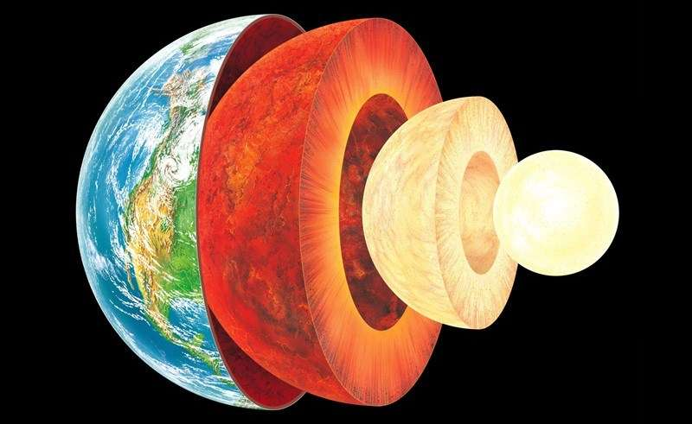

Slide 9
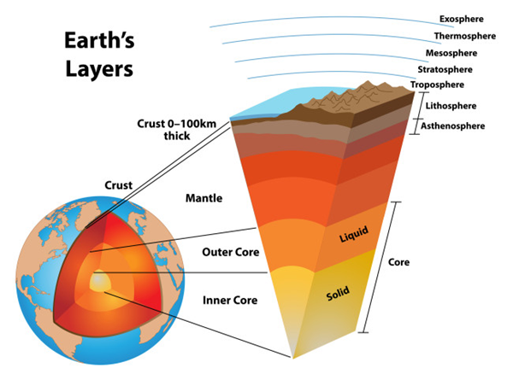

Slide 10
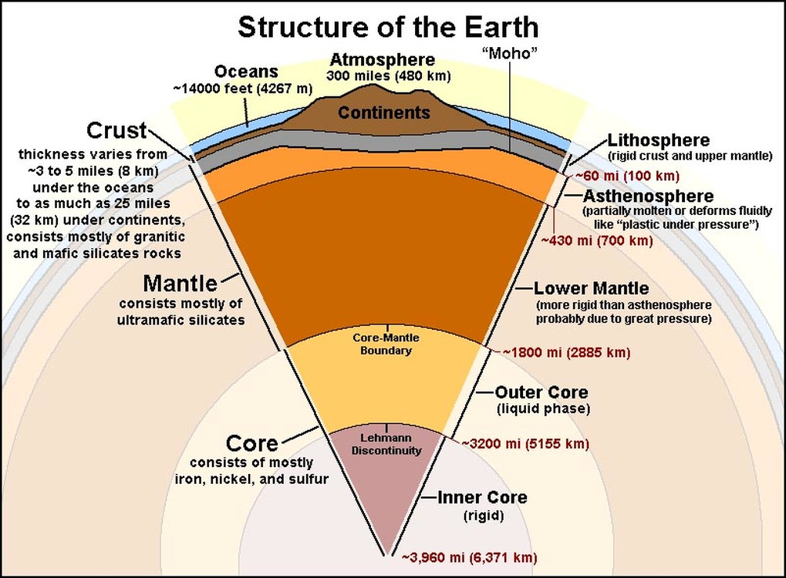

Slide 11
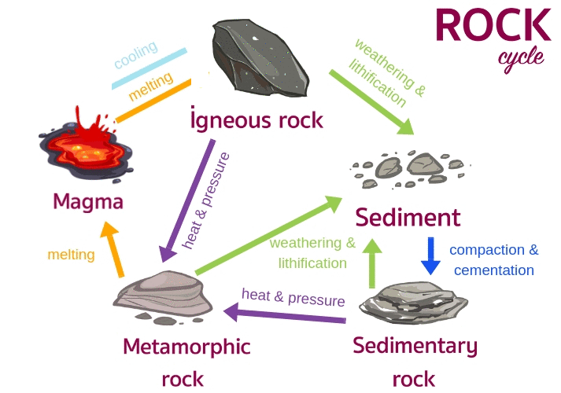

Slide 12
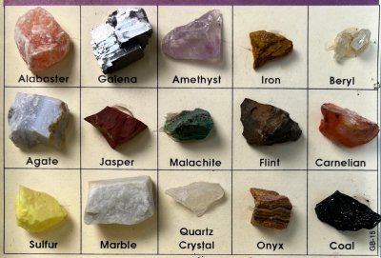
Earth is composed of the approximately 100 naturally occurring chemical elements in a vast number of combinations. However, 98.5% of Earth’s crust is composed of only 8 elements:
oxygen (O),
silicon (Si),
aluminum (Al),
iron (Fe),
calcium (Ca),
sodium (Na),
potassium (K), and magnesium (Mg).
In materials such as gases, liquids, and glass atoms may occur in random proportions, with the atoms having no fixed relationship in space to each other

Slide 13
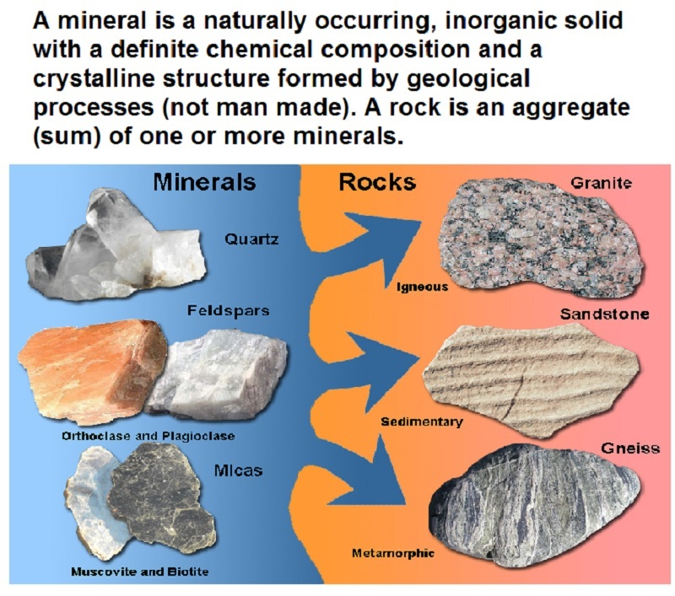

Slide 14
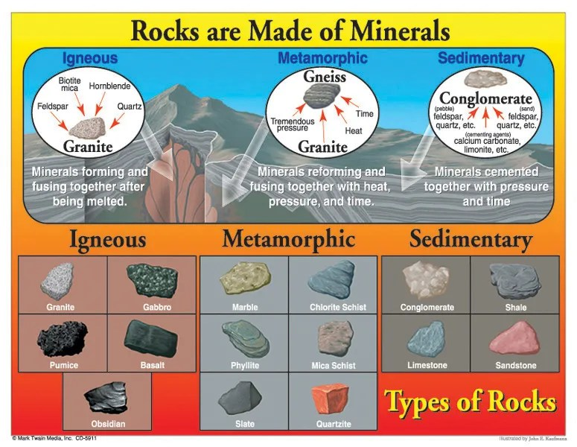

Slide 15
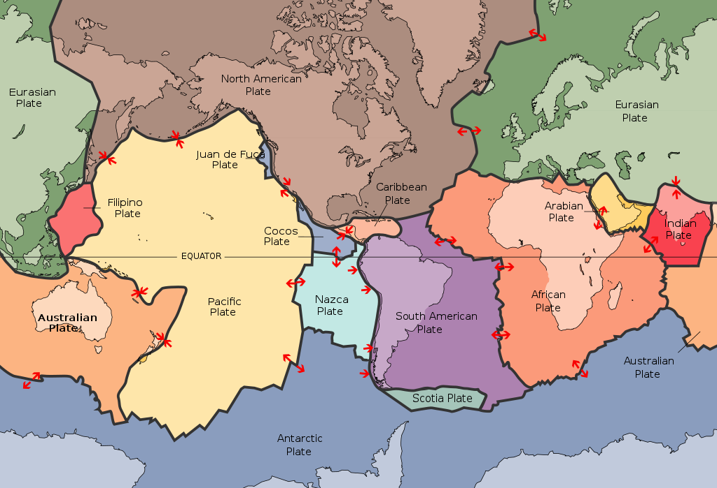
In plate tectonics, Earth’s outermost layer, orlithosphere—made up of the crust and upper mantle—is broken into large rocky plates. These plates lie on top of a partially moltenlayer of rock called the asthenosphere. Due to the convection of the asthenosphere andlithosphere, the plates move relative to each other at different rates, from two to 15 centimeters (one to six inches) per year. Thisinteraction of tectonic plates is responsible for many different geological formations such as the Himalaya mountain range in Asia, the East African Rift, and the San Andreas Fault in California, United States.

Slide 16
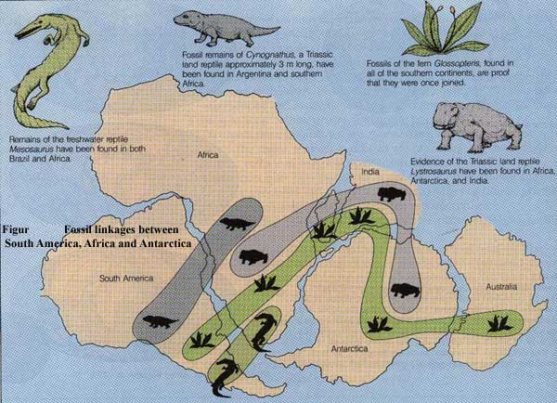
Geologist Israel C White was the first person to report the similarities between coal (fossilized plants) found in Brazilian mines and that found in Africa. His insight helped Alfred Wegener to publish continental drift theory in 1912

Slide 17
S6E5. Obtain, evaluate, and communicate information to show how Earth’s surface is formed.
B Plan and carry out an investigation of the characteristics of minerals and how minerals contribute to rock composition.
F Construct an explanation of how the movement of lithospheric plates, called plate tectonics, can cause major geologic events such as earthquakes and volcanic eruptions. (Clarification statement: Include convergent, divergent, and transform boundaries.)
G Construct an argument using maps and data collected to support a claim of how fossils show evidence of the changing surface and climate of the Earth.

Slide 18

Students will have 15 minutes of Homework each evening.
4 Squares (usually a drawing)
Rock Cycle Puzzle
Chapter 1 or 3 Workbook Pages
Powerpoint Study Guide
Study Notes or Study Guides
Watch Video from Week at a Glance

Slide 19
Resources for Unit 1 A
Weathering and Erosion | What Is the Difference between Weathering and Erosion?
Rocks and Minerals
Fossils and Plate Tectonics
Plate Tectonics

Slide 20
Resources for Unit 1 A
What are the Layers of Earth?
Layers of the Earth
Layers of the Earth – Geology –
The Good and the Beautiful Home school Science 8:47
7 Ways We Know What’s Inside the Earth - SciShow 12:08
An Overview of Earth’s Layers - 10:07

Slide 21
S6E5. Obtain, evaluate, and communicate information to show how Earth’s surface is formed.
Ask questions to compare and contrast the Earth’s crust, mantle, inner and outer core, including temperature, density, thickness, and composition.
Plan and carry out an investigation of the characteristics of minerals and how minerals contribute to rock composition.
Construct an explanation of how to classify rocks by their formation and how rocks change through geologic processes in the rock cycle.
Ask questions to identify types of weathering, agents of erosion and transportation, and environments of deposition. (Clarification statement: Environments of deposition include deltas, barrier islands, beaches, marshes, and rivers.)
Develop a model to demonstrate how natural processes (weathering, erosion, and deposition) and human activity change rocks and the surface of the Earth.
Construct an explanation of how the movement of lithospheric plates, called plate tectonics, can cause major geologic events such as earthquakes and volcanic eruptions. (Clarification statement: Include convergent, divergent, and transform boundaries.)
Construct an argument using maps and data collected to support a claim of how fossils show evidence of the changing surface and climate of the Earth.
Plan and carry out an investigation to provide evidence that soil is composed of layers of weathered rocks and decomposed organic material.

